Slide 1
https://rstudio.cloud/project/1554136

Slide 2
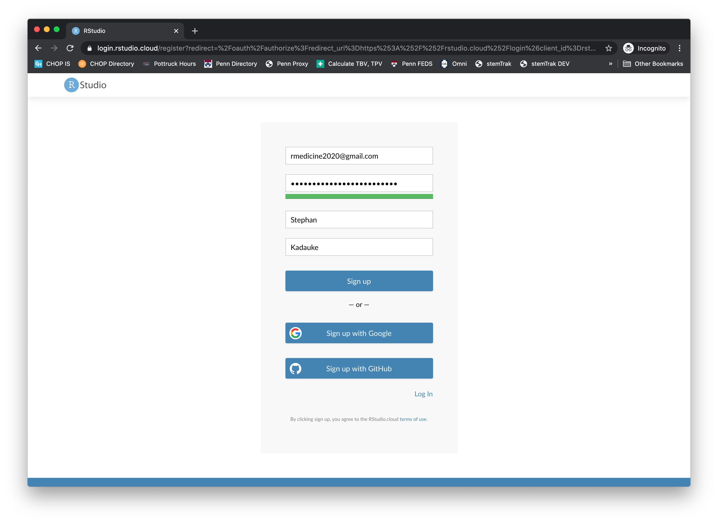

Slide 3
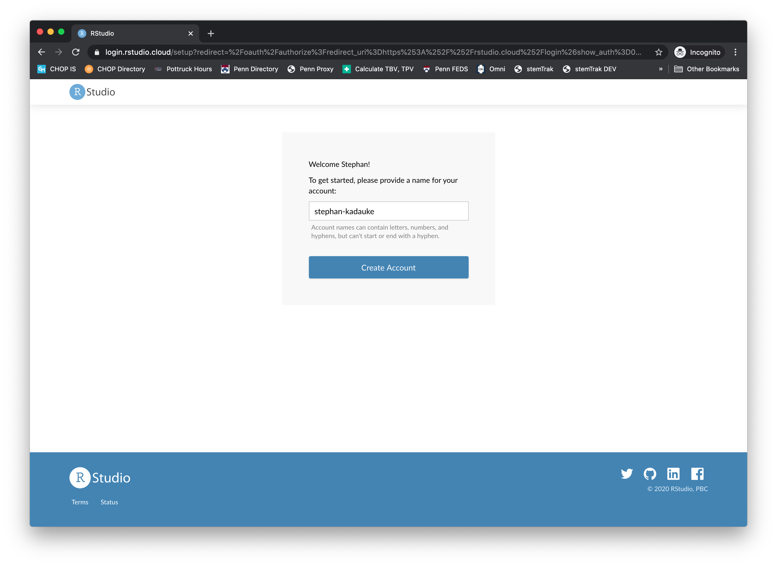

Slide 4
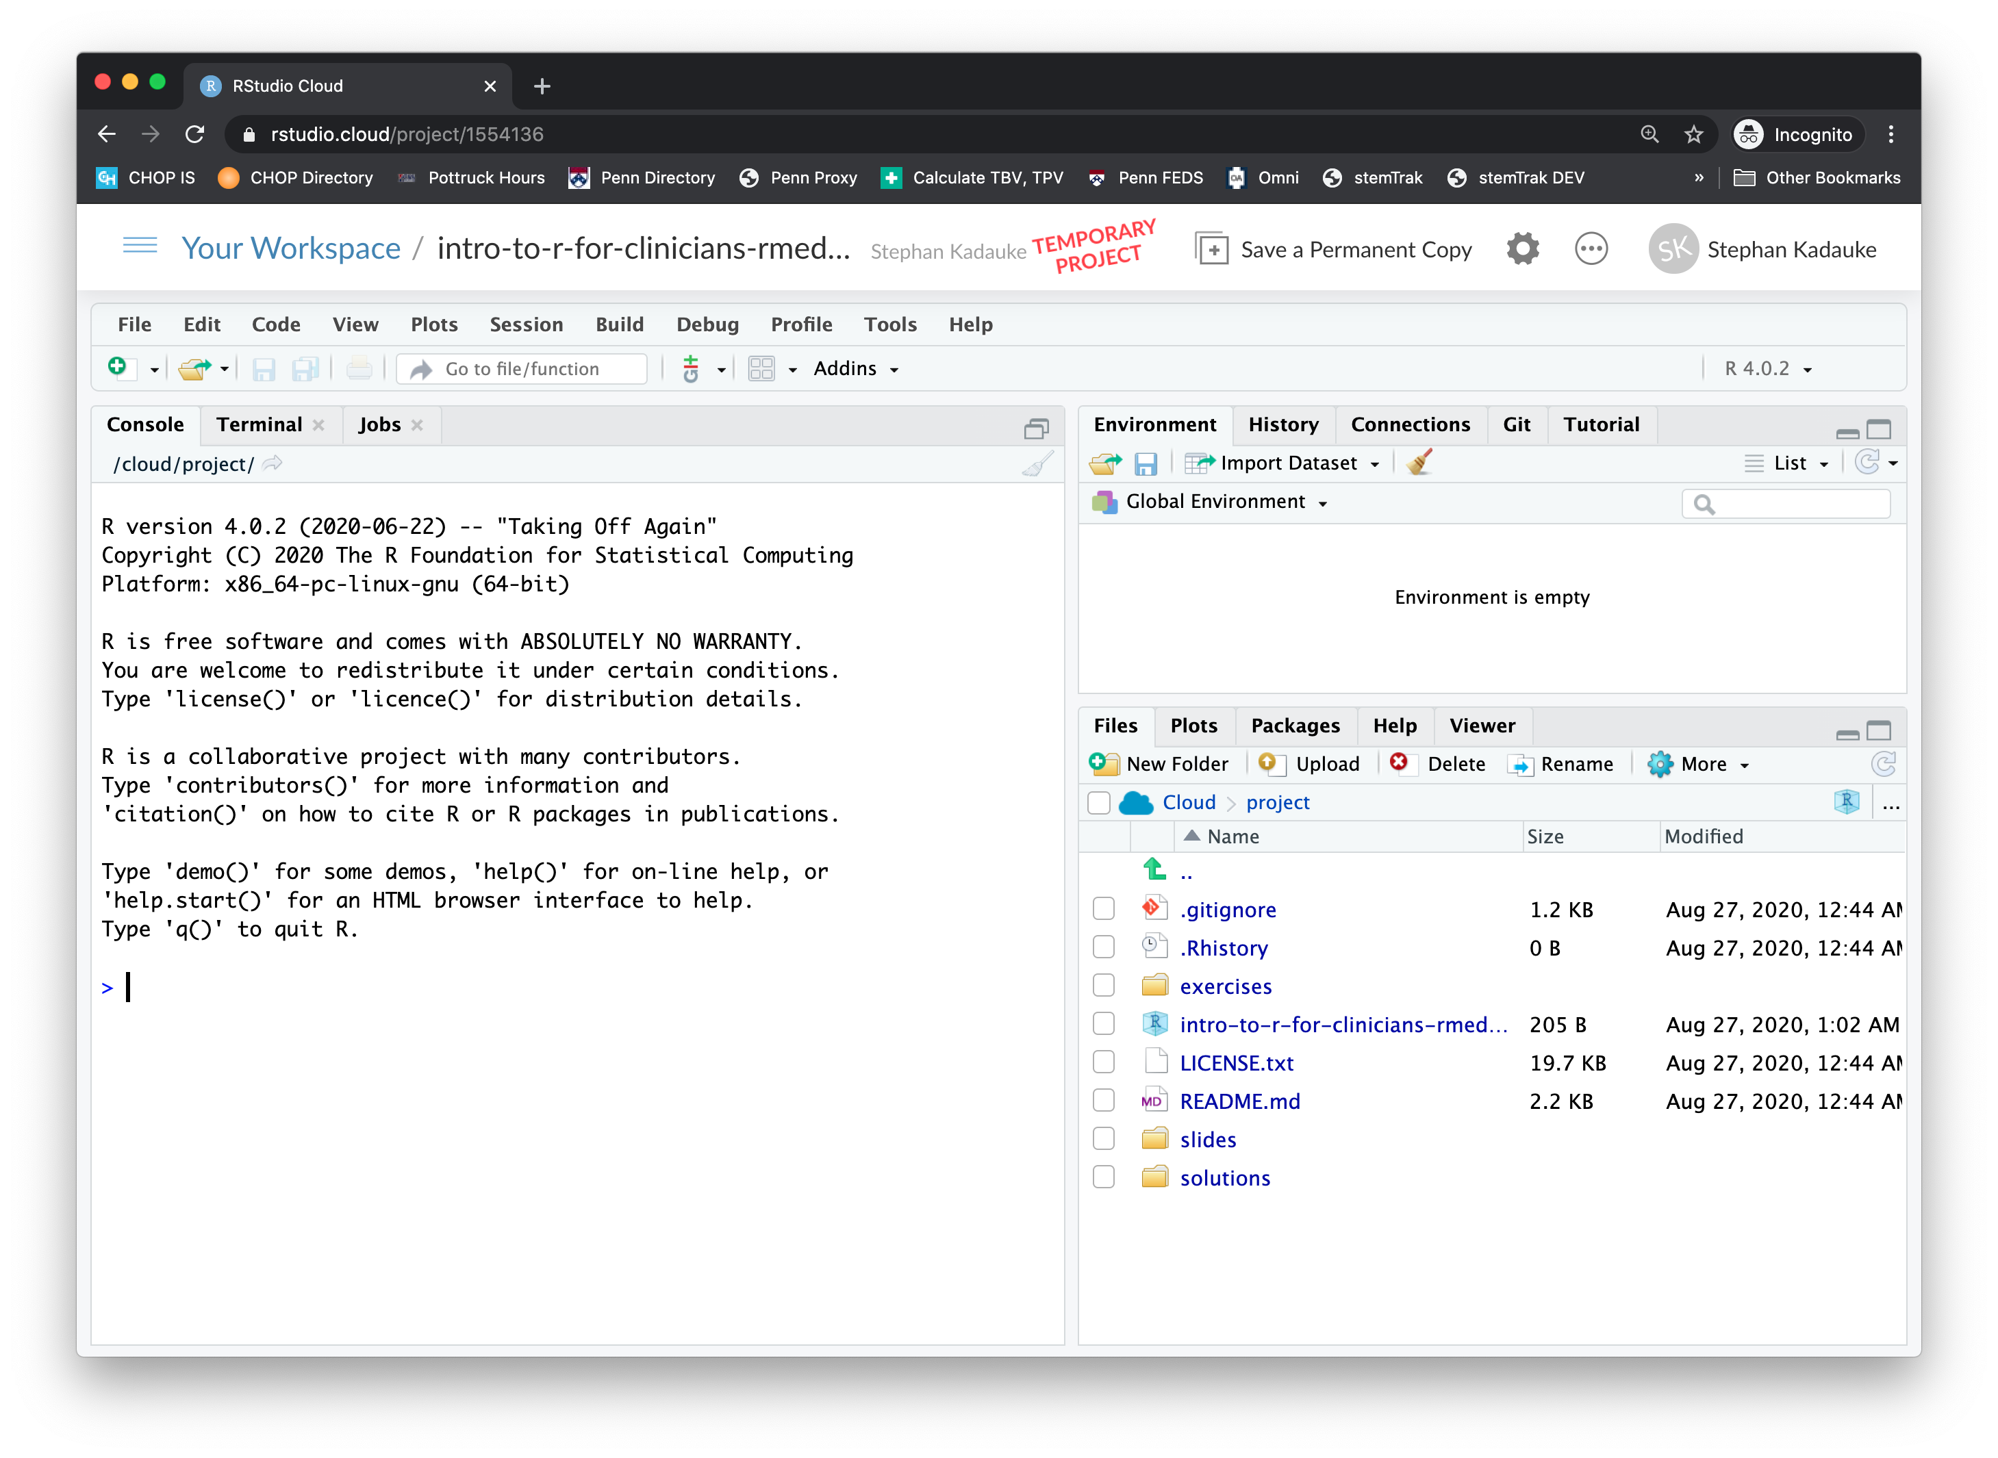

Slide 5
